Slide 1

Mobile Application Development
Workshop

Slide 2

Who we are…?

Slide 3
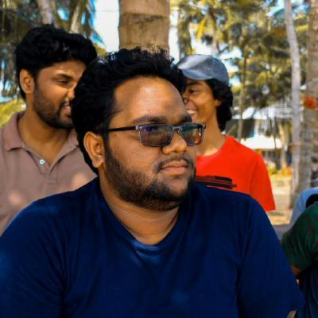
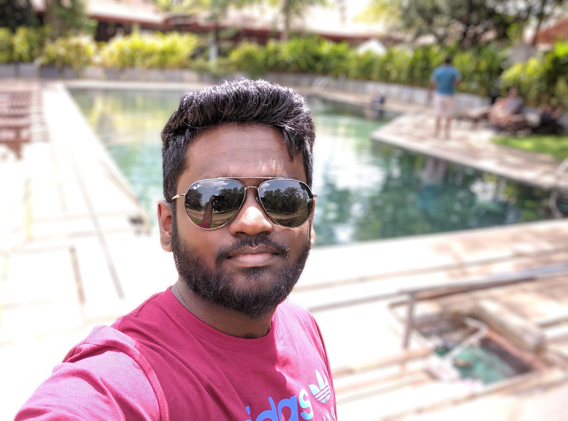
Chathura Hettiarachchi
Associate Tech Lead
Frontend, backend & mobile developer
Android, iOS, ReactJs, RoR, .NET, NodeJS, Python, Team Lead & open source contributor
Nimantha Lakshan
Software Engineer
Mobile & Java developer
Android, iOS, Java SE, Java EE
Shasika Jayawardene
Software Engineer
Mobile developer
Android, iOS

Slide 4



https://www.facebook.com/chathurajh
https://www.linkedin.com/in/chathurajh/
chathura.h@fidenz.com
https://www.facebook.com/nimantha.lakshan.14
https://www.linkedin.com/in/lakshankkn/
nimantha.l@fidenz.com
https://www.facebook.com/janith.shashika
https://www.linkedin.com/in/shashika-jayawardena-40663a8b
shashika.j@fidenz.com

Slide 5
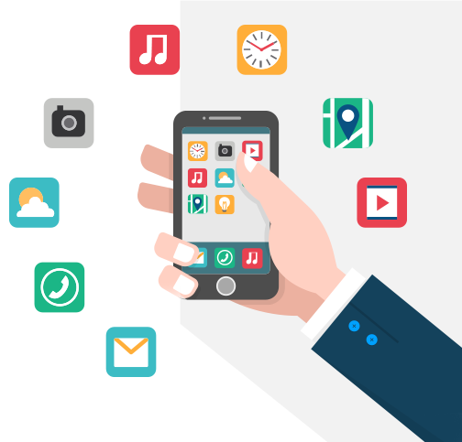
Why mobile
applications?
1
The reason to use mobile application?

Slide 6
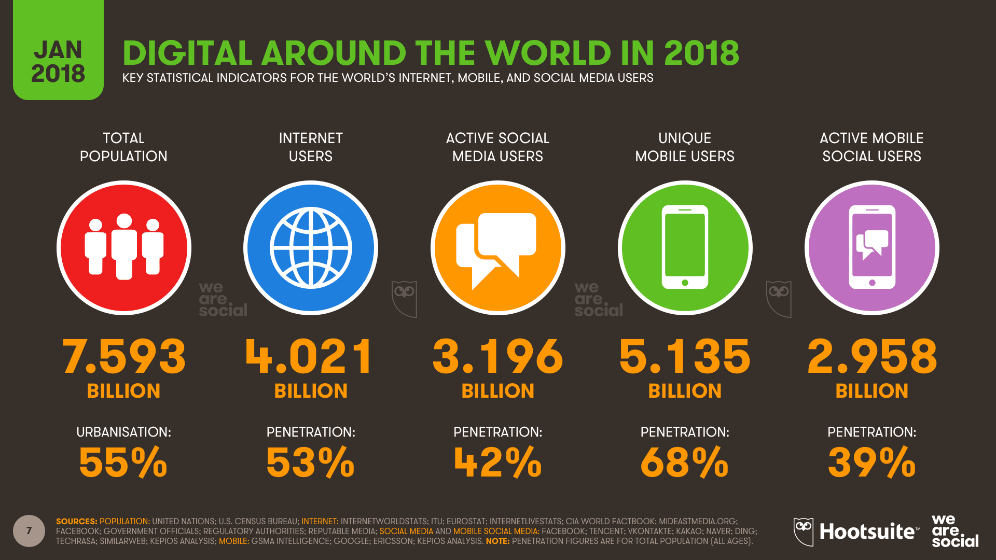

Slide 7
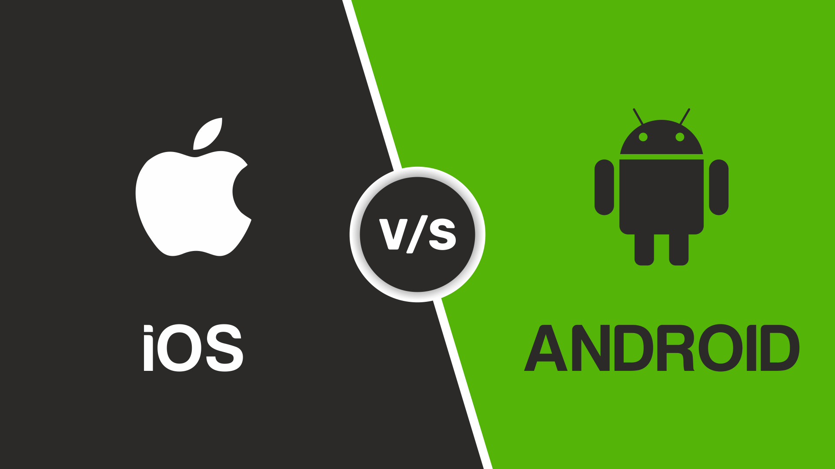

Slide 8
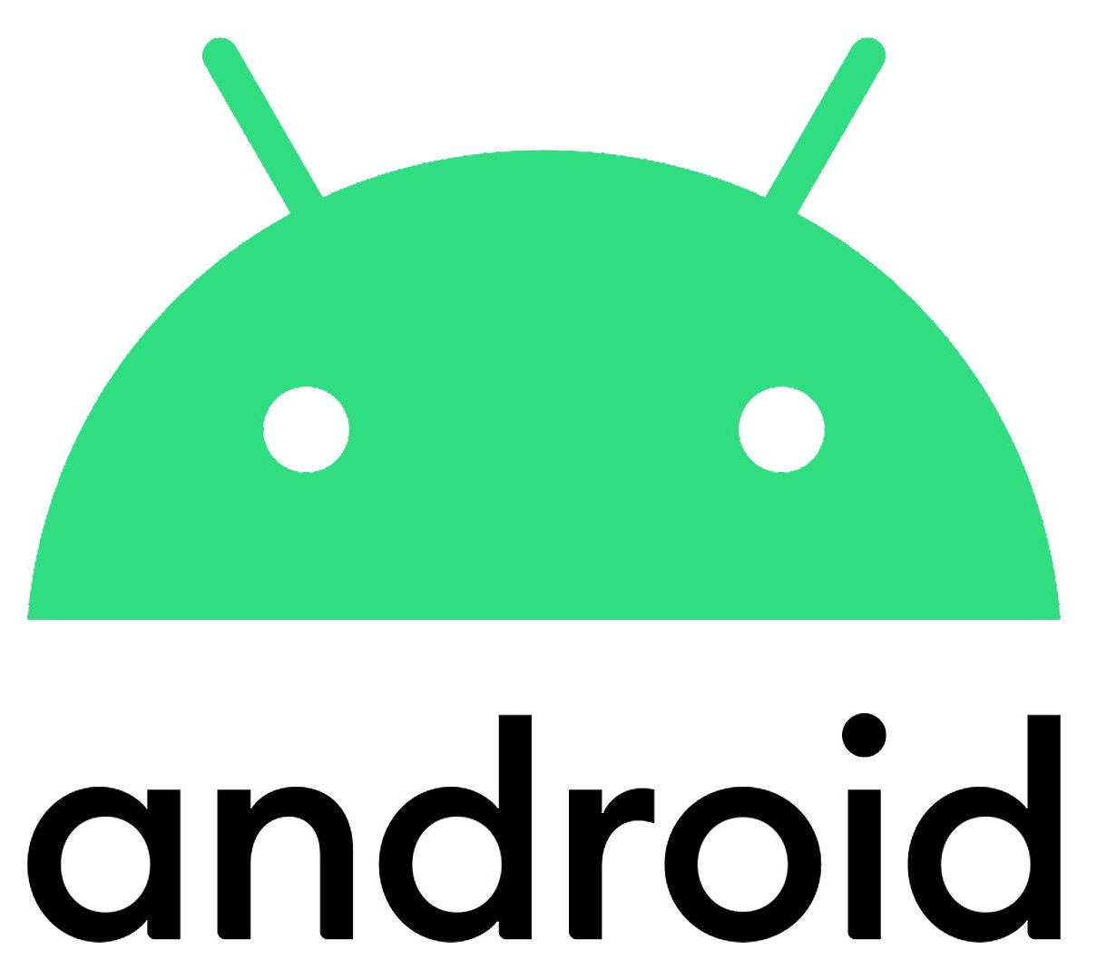

Slide 9
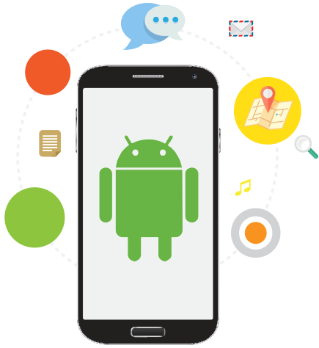
Where We Can
Use
Android?
Tv, watches to everything if it has a screen

Slide 10
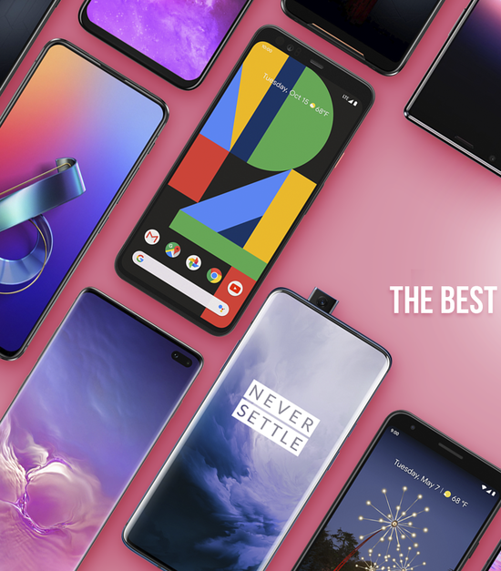
Android Mobile Phones

Slide 11
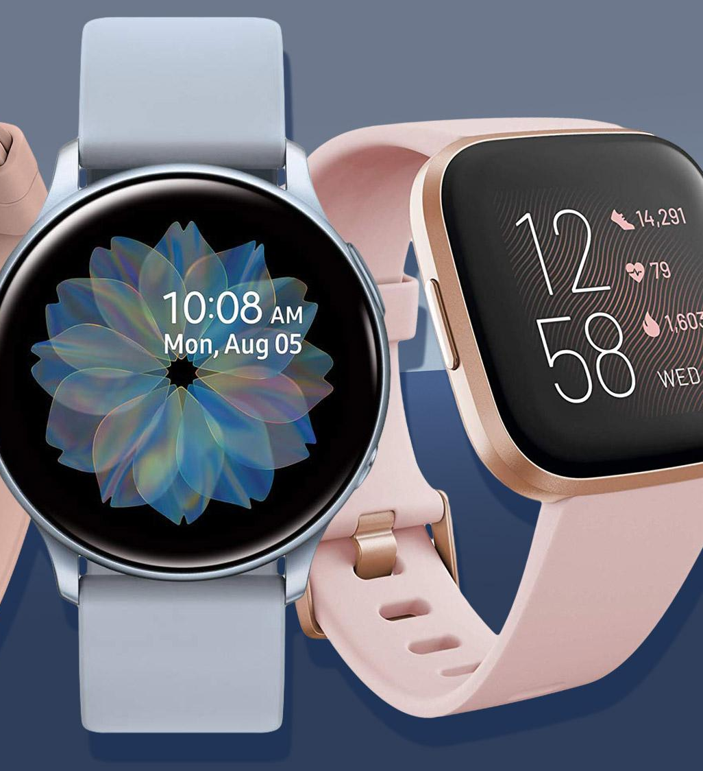
Smart Watch

Slide 12
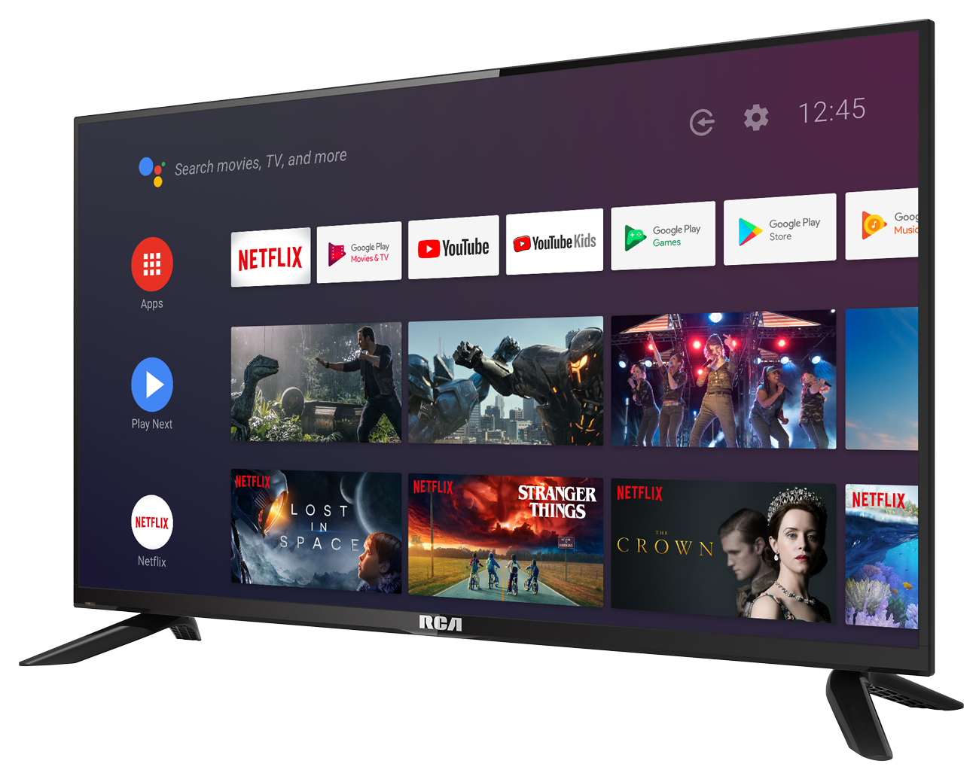
Smart TV

Slide 13
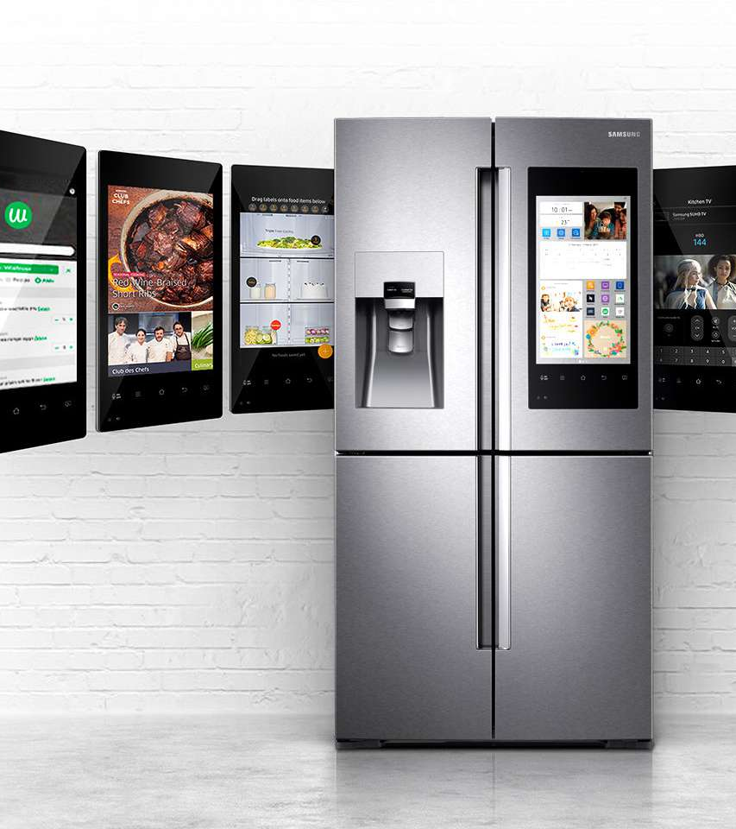
Smart Refrigerators

Slide 14
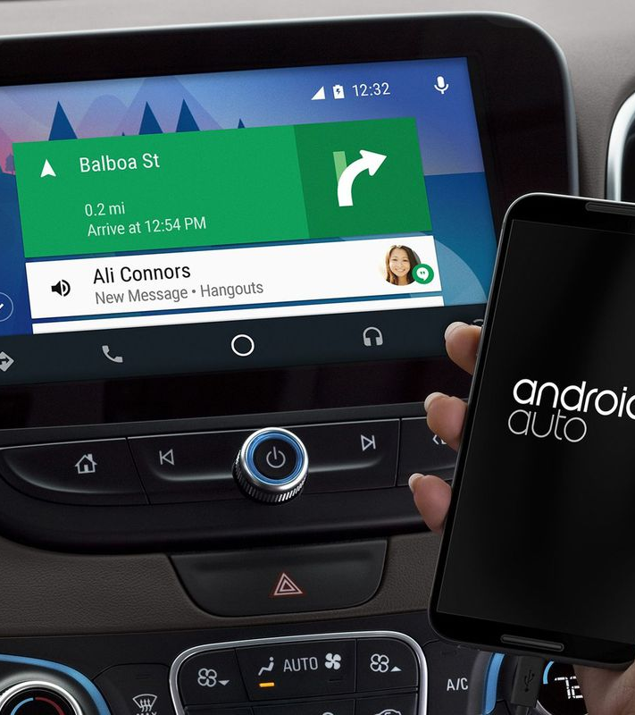
Car Players

Slide 15
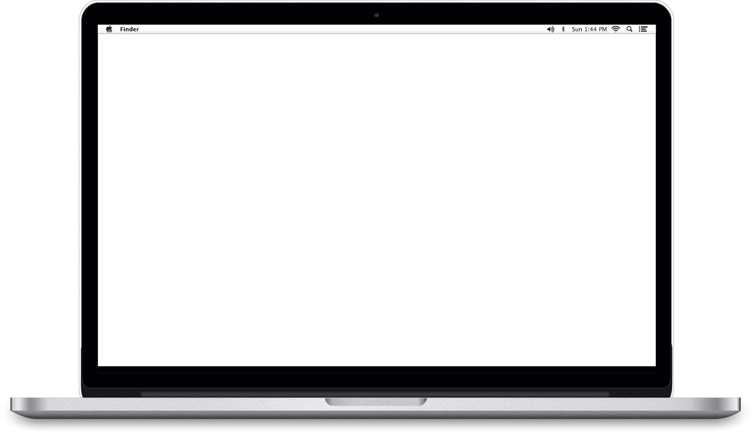
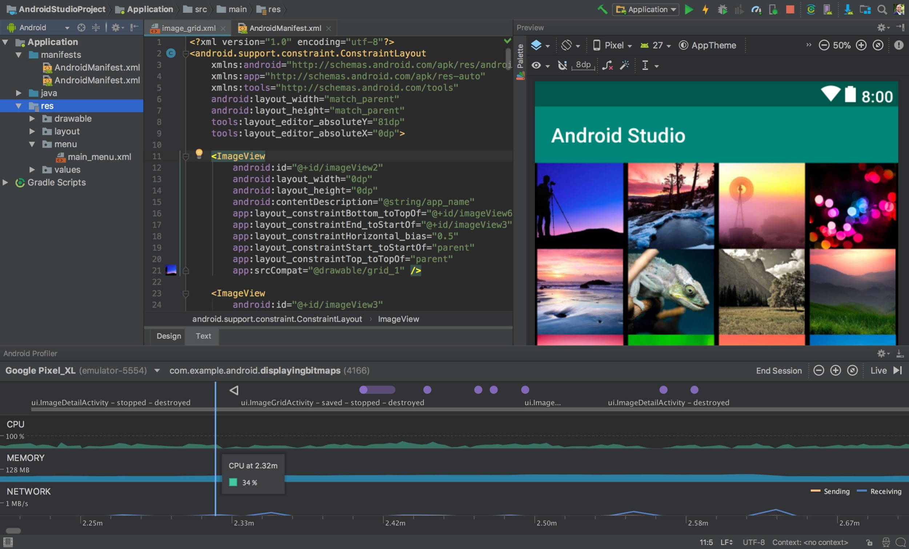
Android
Mobile Application
Development
By Fidenz Technologies

